Slide 1
Managing variability and software testing
Notes:
Modélisation : separation of concerns, orthogonal variability modeling, models@runtime
Test : V&V on variability model, safe migration path

Slide 2
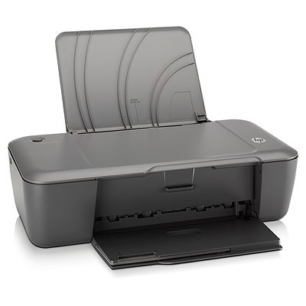


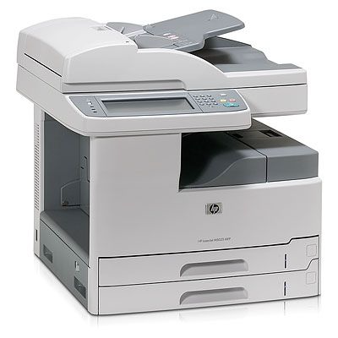

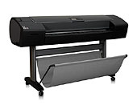
Handling variations
Software product line engineering
Variability intensive systems
Techniques for modeling and implementing variability

Slide 3
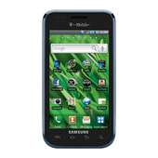
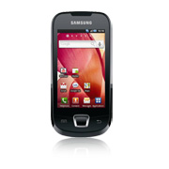
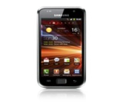

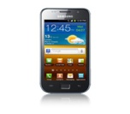


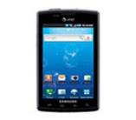
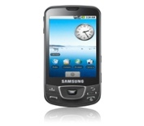
Handling variations
Software product line engineering
and
Variability intensive systems

Slide 4



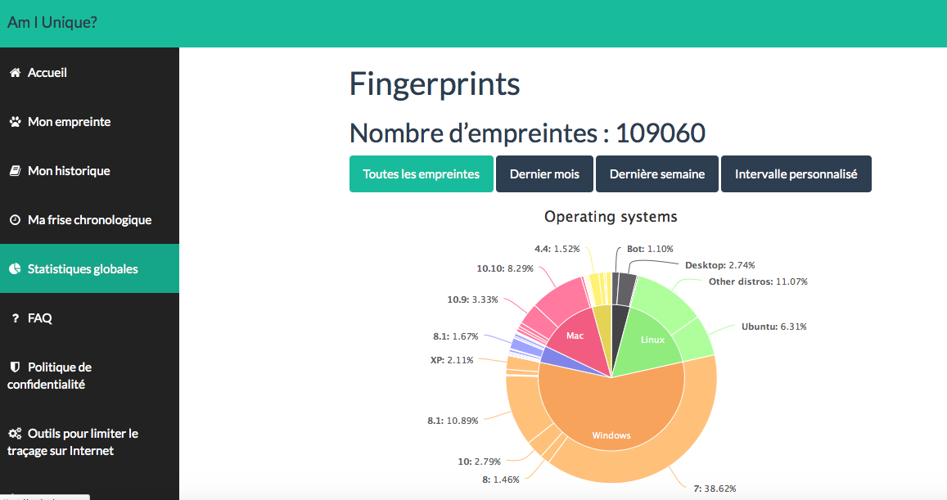

Software intensive systems
are declined in many variants
Notes:
My research interest is essentially related to software systems and more generally to software intensive systems.
There are many examples of software intensive systems in many domains that populate our daily life (at home, at work, on the road, in the car).
Perhaps the most popular and well-known example of software intensive system is a mobile phone.
If we can send and receive messages, if we can take photos, use the GPS to navigate with a car or perform a bank transaction with a mobile phone, that’s because of the software embedded in the device.
You have a software operating system that manages hardware resources of the mobile phone and you have plenty of software applications that are developed every day.
One major challenge for mobile phone companies like Nokia, Samsung or Apple is to propose to customers all over the word different models of a mobile phone, with different sizes, language support, functionalities, hardware capabilities.
In other words, these companies should be able to develop software not only for one unique model of mobile phone, but rather for different variants of a mobile phone.
Managing the increasing diversity of software intensive systems is obviously a difficult engineering challenge.
A general approach consists in using high level abstractions (models, specifications) to tackle the complexity and diversity of software intensive systems. With a model, software engineers can more easily and efficiently formalize the properties expected from a given system and automatically reason about these properties. These models can also be used to automatically generate software variants at a higher level of abstraction.
Generally, due to the complexity and diversity of software intensive systems, using one specification or one model is neither adequate nor feasible. A multiplicity of models are rather used.
If we consider the software of a mobile phone, we have to specify different concerns: the operating system, the hardware components of the device, the security of the applications, etc.
As we want to handle the diversity of products, a multiplicity of variability models is used.
By software intensive systems, I mean systems that make extensive use of software.
There are plenty of examples, and, for the sake of simplicity, I will take a well known example of a software intensive system, a mobile phone (also called smart phone).
2’30
TODO: need a human + automated + precise
Zoom the upper part and then reduce
Principle widely used in industry
Large product lines of elements
CARS
Software systems
Software Creation and Maintenance
We need formalisms
Complex in size
Nowadays there are a variety of descriptions
Provision of operators
+ merge / slice (notation)
Language
Applications

Slide 5
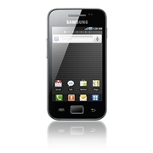
Software intensive systems
are declined in many variants
Notes:
My research interest is essentially related to software systems and more generally to software intensive systems.
There are many examples of software intensive systems in many domains that populate our daily life (at home, at work, on the road, in the car).
Perhaps the most popular and well-known example of software intensive system is a mobile phone.
If we can send and receive messages, if we can take photos, use the GPS to navigate with a car or perform a bank transaction with a mobile phone, that’s because of the software embedded in the device.
You have a software operating system that manages hardware resources of the mobile phone and you have plenty of software applications that are developed every day.
One major challenge for mobile phone companies like Nokia, Samsung or Apple is to propose to customers all over the word different models of a mobile phone, with different sizes, language support, functionalities, hardware capabilities.
In other words, these companies should be able to develop software not only for one unique model of mobile phone, but rather for different variants of a mobile phone.
Managing the increasing diversity of software intensive systems is obviously a difficult engineering challenge.
A general approach consists in using high level abstractions (models, specifications) to tackle the complexity and diversity of software intensive systems. With a model, software engineers can more easily and efficiently formalize the properties expected from a given system and automatically reason about these properties. These models can also be used to automatically generate software variants at a higher level of abstraction.
Generally, due to the complexity and diversity of software intensive systems, using one specification or one model is neither adequate nor feasible. A multiplicity of models are rather used.
If we consider the software of a mobile phone, we have to specify different concerns: the operating system, the hardware components of the device, the security of the applications, etc.
As we want to handle the diversity of products, a multiplicity of variability models is used.
By software intensive systems, I mean systems that make extensive use of software.
There are plenty of examples, and, for the sake of simplicity, I will take a well known example of a software intensive system, a mobile phone (also called smart phone).
2’30
TODO: need a human + automated + precise
Zoom the upper part and then reduce
Principle widely used in industry
Large product lines of elements
CARS
Software systems
Software Creation and Maintenance
We need formalisms
Complex in size
Nowadays there are a variety of descriptions
Provision of operators
+ merge / slice (notation)
Language
Applications

Slide 6
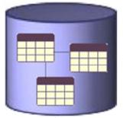
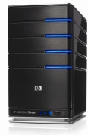


Database
Engine

Slide 7


Printer Firmware

Slide 8
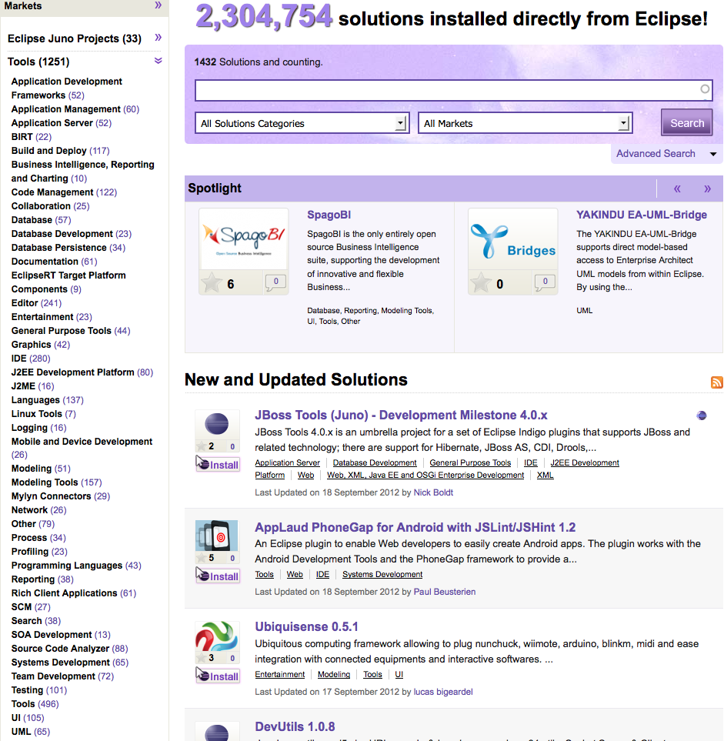
Eclipse and plugins

Slide 9
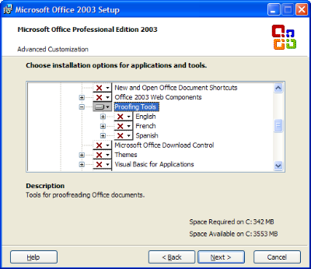
Features in Microsoft Office

Slide 10
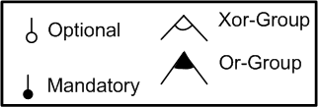
Feature Models
describe the common and variable features (characteristics) of a system under study (SUS)
Notes:
Mobile phone: stop quoi
Medical Imaging quoi
Jusqu’à maintenant……..
On va se familiariser………
I made the choice of presenting………
An excerpt of the medical imaging analysis domain…… (justify)
Ref sur les feature models
A feature model is a hierarchy of features with variabilty
The primary purpose of the hierarchy is to organize features into multiple levels of increasing detail
Variability deﬁnes what the allowed combinations of features are.
Variability in a feature model is expressed through different mechanisms.
describes a set of valid feature combinations.

Slide 11
SPL AND TESTING

Slide 12
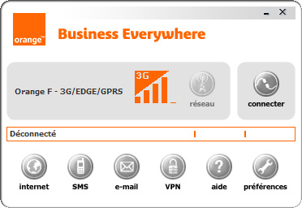
Context: Orange BIEW Software
BIEW : BusIness Every Where
Professional in mobility
Handle 3G - wifi – Ethernet
Large number of functionalities :
SMS
Email
VPN…
Notes:
Small introduction about kereval the company:
We do software testing, and we have got nice client

Slide 13
An Industrial Test Project
5 years of testing activities
7 testers
Many version of the BIEW application validated :
For a version :
From 100 to 400 p.days
Average of 300 p.days
Notes:
Small introduction about kereval the company:
We do software testing, and we have got nice client

Slide 14
Orange Specifications
A large environment specification:
OS (5): Win. 2000, Win. XP 32 bits, Win. XP 64 bits, Win. Vista 32 bits,Win. Vista 64 bits
Mobile (25): Novatel Xu870, GT Max GX0301, Lucent Merlin U530, Huawei, E870...
Wifi internal (5): intel centrino 2100, 2200, 2915, 3945,
Wifi external(8): Sagem 706 A, Sagem 703...
Modem (8): Sagem F@st 800 USB, Thomson ST330, Siemens A100, ZTE ZXDSL 852...
VPN (4): Safenet, Cisco, Avasy, empty
Mail Client (4): Outlook, Outlook Express, Windows Live Mail, empty
Browser (4): Firefox 2.0, Firefox 1.5, Internet Explorer 5.5, empty
Notes:
Small introduction about kereval the company:
We do software testing, and we have got nice client

Slide 15

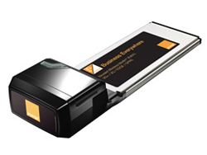




Orange Specifications
A large environment specification:
OS (5): Win. 2000, Win. XP 32 bits, Win. XP 64 bits, Win. Vista 32 bits,Win. Vista 64 bits
Mobile (25): Novatel Xu870, GT Max GX0301, Lucent Merlin U530, Huawei, E870...
Wifi internal (5): intel centrino 2100, 2200, 2915, 3945,
Wifi external(8): Sagem 706 A, Sagem 703...
Modem (8): Sagem F@st 800 USB, Thomson ST330, Siemens A100, ZTE ZXDSL 852...
VPN (4): Safenet, Cisco, Avasy, empty
Mail Client (4): Outlook, Outlook Express, Windows Live Mail, empty
Browser (4): Firefox 2.0, Firefox 1.5, Internet Explorer 5.5, empty
A Configuration, a selection of 1 element of each category :
Setting up an environment take human and material resources
Notes:
Small introduction about kereval the company:
We do software testing, and we have got nice client

Slide 16
Challenges
Large number of configurations
2.560.000* different environments
Many Functionalities:
1461 requirements
How to test those 1461 requirements over this 2.560.000 environments ?
An Exhaustive Approach :
1461 * 2.560.000 = 3.7*10⁹ TC to execute to verify each requirement in each configuration
=#OS*#Mobile*#WifiInt*#WiFiExt*#Modem*#VPN*#MailClient*#Browser

Slide 17
Challenges
How to select a subset of configurations in order to
Cover requirements
Obtain a manageable number of test case to execute
Notes:
Small introduction about kereval the company:
We do software testing, and we have got nice client

Slide 18

Process
Requirements Analysis
Test Case Selection
Test Case Execution
Environment Spec.
Requirements
Notes:
Small introduction about kereval the company:
We do software testing, and we have got nice client

Slide 19
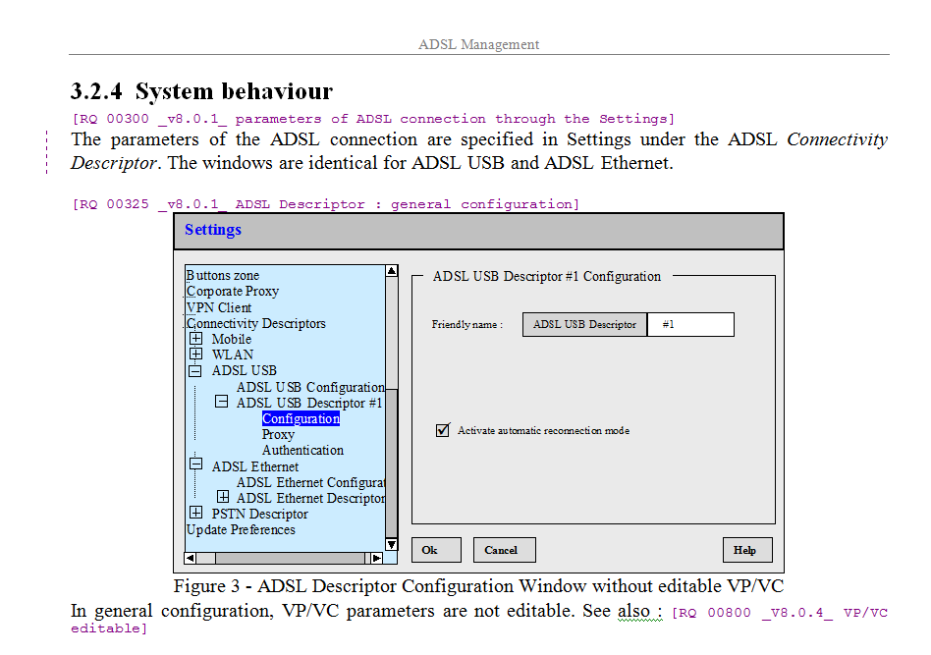
Notes:
Small introduction about kereval the company:
We do software testing, and we have got nice client

Slide 20
Functional Domain
Notes:
Small introduction about kereval the company:
We do software testing, and we have got nice client

Slide 21
Unique ID
Notes:
Small introduction about kereval the company:
We do software testing, and we have got nice client

Slide 22
Version Number
Notes:
Small introduction about kereval the company:
We do software testing, and we have got nice client

Slide 23
Summary of the requirement
Notes:
Small introduction about kereval the company:
We do software testing, and we have got nice client

Slide 24
Detailed Explanation
Notes:
Small introduction about kereval the company:
We do software testing, and we have got nice client

Slide 25
Requirement material
Associate each requirement to 0,1 or 2 environment category
1461 requirements
43 functional domains (Phone Book, Lan management, ADSL Management…) :
33 (841 requirements) contain environment dependent requirements
15 persons-day
[RQ 00300 _v8.0.1_ parameters of ADSL connection through the Settings][MODEM] The parameters of the ADSL connection are specified in Settings under the ADSL Connectivity Descriptor. The windows are identical for ADSL USB and ADSL Ethernet.
Notes:
Small introduction about kereval the company:
We do software testing, and we have got nice client

Slide 26
Process
Requirements Analysis
Test Case Selection
Test Case Execution
Environment Spec.
Requirements
Notes:
Small introduction about kereval the company:
We do software testing, and we have got nice client

Slide 27
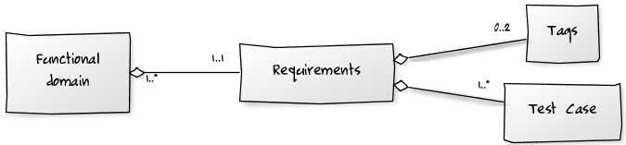
Test Cases Selection
Associate concrete test cases to each requirements
Quality Center handles Test Cases
Design variability matrix, that identify which test case have to be executed on which environment.
Notes:
Small introduction about kereval the company:
We do software testing, and we have got nice client

Slide 28
Test Cases Selection
Each functional domain leads to the creation of a variability matrix.
Rules are applied to reduce the number of test execution
 |  | Vista Pro |  |  |  |  |  |  | XP SP2
 |  | Sagem F@st 800 USB | ZTE ZXDSL 852 | Thomson ST330 | ZTE ROHS | Bewan ADSL2+ Combo | Siemens A-100 | Thomson ST 510 | Sagem F@st 800 USB | ZTE ZXDSL 852 | Thomson ST330 | ZTE ROHS | Bewan ADSL2+ Combo | Siemens A-100 | Thomson ST 510
Requirement | Dependencies
RQ 300 | OS + Mobile
RQ 325 | Mobile
RQ 350 | OS
RQ 375 | None
Notes:
Small introduction about kereval the company:
We do software testing, and we have got nice client

Slide 29
Test Cases Selection
 |  | Vista Pro |  |  |  |  |  |  | XP SP2
 |  | Sagem F@st 800 USB | ZTE ZXDSL 852 | Thomson ST330 | ZTE ROHS | Bewan ADSL2+ Combo | Siemens A-100 | Thomson ST 510 | Sagem F@st 800 USB | ZTE ZXDSL 852 | Thomson ST330 | ZTE ROHS | Bewan ADSL2+ Combo | Siemens A-100 | Thomson ST 510
Requirement | Dependencies
RQ 300 | OS + Mobile
RQ 325 | Mobile
RQ 350 | OS
RQ 375 | None
56 Test cases
Notes:
Small introduction about kereval the company:
We do software testing, and we have got nice client

Slide 30
Test Cases Selection
 |  | Vista Pro |  |  |  |  |  |  | XP SP2
 |  | Sagem F@st 800 USB | ZTE ZXDSL 852 | Thomson ST330 | ZTE ROHS | Bewan ADSL2+ Combo | Siemens A-100 | Thomson ST 510 | Sagem F@st 800 USB | ZTE ZXDSL 852 | Thomson ST330 | ZTE ROHS | Bewan ADSL2+ Combo | Siemens A-100 | Thomson ST 510
Requirement | Dependencies
RQ 300 | OS + Mobile
RQ 325 | Mobile
RQ 350 | OS
RQ 375 | None
56 Test cases
R1 : if the rq depends of one environment category, we test each element one time
Notes:
Small introduction about kereval the company:
We do software testing, and we have got nice client

Slide 31
Test Cases Selection
 |  | Vista Pro |  |  |  |  |  |  | XP SP2
 |  | Sagem F@st 800 USB | ZTE ZXDSL 852 | Thomson ST330 | ZTE ROHS | Bewan ADSL2+ Combo | Siemens A-100 | Thomson ST 510 | Sagem F@st 800 USB | ZTE ZXDSL 852 | Thomson ST330 | ZTE ROHS | Bewan ADSL2+ Combo | Siemens A-100 | Thomson ST 510
Requirement | Dependencies
RQ 300 | OS + Mobile
RQ 325 | Mobile
RQ 350 | OS
RQ 375 | None
56 Test cases
R1 : 44 TC
R1 : if the rq depends of one environment category, we test each element one time
Notes:
Small introduction about kereval the company:
We do software testing, and we have got nice client

Slide 32
Test Cases Selection
 |  | Vista Pro |  |  |  |  |  |  | XP SP2
 |  | Sagem F@st 800 USB | ZTE ZXDSL 852 | Thomson ST330 | ZTE ROHS | Bewan ADSL2+ Combo | Siemens A-100 | Thomson ST 510 | Sagem F@st 800 USB | ZTE ZXDSL 852 | Thomson ST330 | ZTE ROHS | Bewan ADSL2+ Combo | Siemens A-100 | Thomson ST 510
Requirement | Dependencies
RQ 300 | OS + Mobile
RQ 325 | Mobile
RQ 350 | OS
RQ 375 | None
56 Test cases
R1 : 44 TC
R1 : if the rq depends of one environment category, we test each element one time
Notes:
Small introduction about kereval the company:
We do software testing, and we have got nice client

Slide 33
Test Cases Selection
 |  | Vista Pro |  |  |  |  |  |  | XP SP2
 |  | Sagem F@st 800 USB | ZTE ZXDSL 852 | Thomson ST330 | ZTE ROHS | Bewan ADSL2+ Combo | Siemens A-100 | Thomson ST 510 | Sagem F@st 800 USB | ZTE ZXDSL 852 | Thomson ST330 | ZTE ROHS | Bewan ADSL2+ Combo | Siemens A-100 | Thomson ST 510
Requirement | Dependencies
RQ 300 | OS + Mobile
RQ 325 | Mobile
RQ 350 | OS
RQ 375 | None
56 Test cases
R1: 44 TC
R1: 37 TC
R1 : if the rq depends of one environment category, we test each element one time
Notes:
Small introduction about kereval the company:
We do software testing, and we have got nice client

Slide 34
Test Cases Selection
 |  | Vista Pro |  |  |  |  |  |  | XP SP2
 |  | Sagem F@st 800 USB | ZTE ZXDSL 852 | Thomson ST330 | ZTE ROHS | Bewan ADSL2+ Combo | Siemens A-100 | Thomson ST 510 | Sagem F@st 800 USB | ZTE ZXDSL 852 | Thomson ST330 | ZTE ROHS | Bewan ADSL2+ Combo | Siemens A-100 | Thomson ST 510
Requirement | Dependencies
RQ 300 | OS + Mobile
RQ 325 | Mobile
RQ 350 | OS
RQ 375 | None
56 Test cases
R1: 44 TC
R1: 37 TC
R1 : if the rq depends of one environment category, we test each element one time
R2 : if the rq does not depend of the environment, we test it one time
Notes:
Small introduction about kereval the company:
We do software testing, and we have got nice client

Slide 35
Test Cases Selection
 |  | Vista Pro |  |  |  |  |  |  | XP SP2
 |  | Sagem F@st 800 USB | ZTE ZXDSL 852 | Thomson ST330 | ZTE ROHS | Bewan ADSL2+ Combo | Siemens A-100 | Thomson ST 510 | Sagem F@st 800 USB | ZTE ZXDSL 852 | Thomson ST330 | ZTE ROHS | Bewan ADSL2+ Combo | Siemens A-100 | Thomson ST 510
Requirement | Dependencies
RQ 300 | OS + Mobile
RQ 325 | Mobile
RQ 350 | OS
RQ 375 | None
56 Test cases
R1: 44 TC
R1: 37 TC
R2 : 24 TC
R1 : if the rq depends of one environment category, we test each element one time
R2 : if the rq does not depend of the environment, we test it one time
Notes:
Small introduction about kereval the company:
We do software testing, and we have got nice client

Slide 36
Test Cases Selection
 |  | Vista Pro |  |  |  |  |  |  | XP SP2
 |  | Sagem F@st 800 USB | ZTE ZXDSL 852 | Thomson ST330 | ZTE ROHS | Bewan ADSL2+ Combo | Siemens A-100 | Thomson ST 510 | Sagem F@st 800 USB | ZTE ZXDSL 852 | Thomson ST330 | ZTE ROHS | Bewan ADSL2+ Combo | Siemens A-100 | Thomson ST 510
Requirement | Dependencies
RQ 300 | OS + Mobile
RQ 325 | Mobile
RQ 350 | OS
RQ 375 | None
56 Test cases
R1: 44 TC
R1: 37 TC
R2 : 24 TC
R1 : if the rq depends of one environment category, we test each element one time
R2 : if the rq does not depend of the environment, we test it one time
R3 : if the rd depends of 2 environment category, we test everything
Notes:
Small introduction about kereval the company:
We do software testing, and we have got nice client

Slide 37
Test Cases Selection
 |  | Vista Pro |  |  |  |  |  |  | XP SP2
 |  | Sagem F@st 800 USB | ZTE ZXDSL 852 | Thomson ST330 | ZTE ROHS | Bewan ADSL2+ Combo | Siemens A-100 | Thomson ST 510 | Sagem F@st 800 USB | ZTE ZXDSL 852 | Thomson ST330 | ZTE ROHS | Bewan ADSL2+ Combo | Siemens A-100 | Thomson ST 510
Requirement | Dependencies
RQ 300 | OS + Mobile
RQ 325 | Mobile
RQ 350 | OS
RQ 375 | None
56 Test cases
R1: 44 TC
R1: 37 TC
R2 : 24 TC
From 70 test cases -> 24 TC
Notes:
Small introduction about kereval the company:
We do software testing, and we have got nice client

Slide 38
Test Cases Selection
BIEW project : 33 variability matrices
Rules application : 10603 test case to execute instead of 33685 + 1871 (non environment dependent requirement)
Notes:
Small introduction about kereval the company:
We do software testing, and we have got nice client

Slide 39
Process
Requirements Analysis
Test Case Selection
Test Case Execution
Environment Spec.
Requirements
Notes:
Small introduction about kereval the company:
We do software testing, and we have got nice client

Slide 40
Test case execution
Functional domains and test cases are stored in quality center
Tester associates variability matrix to each functional domain
During test execution, testers handle separately each variability matrix and report test verdict in QC.
Tester do not capitalize test environment.
Setting up a test environment takes time.
Notes:
Small introduction about kereval the company:
We do software testing, and we have got nice client

Slide 41
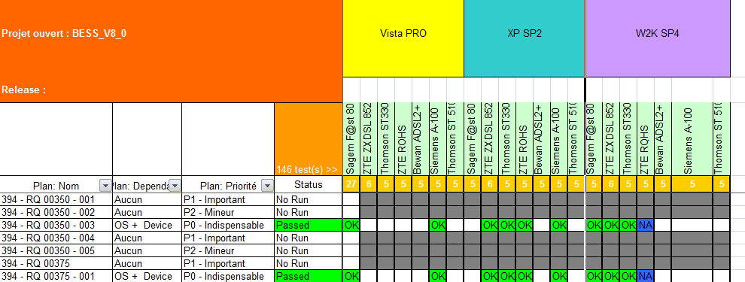
Test case execution
Notes:
Small introduction about kereval the company:
We do software testing, and we have got nice client

Slide 42
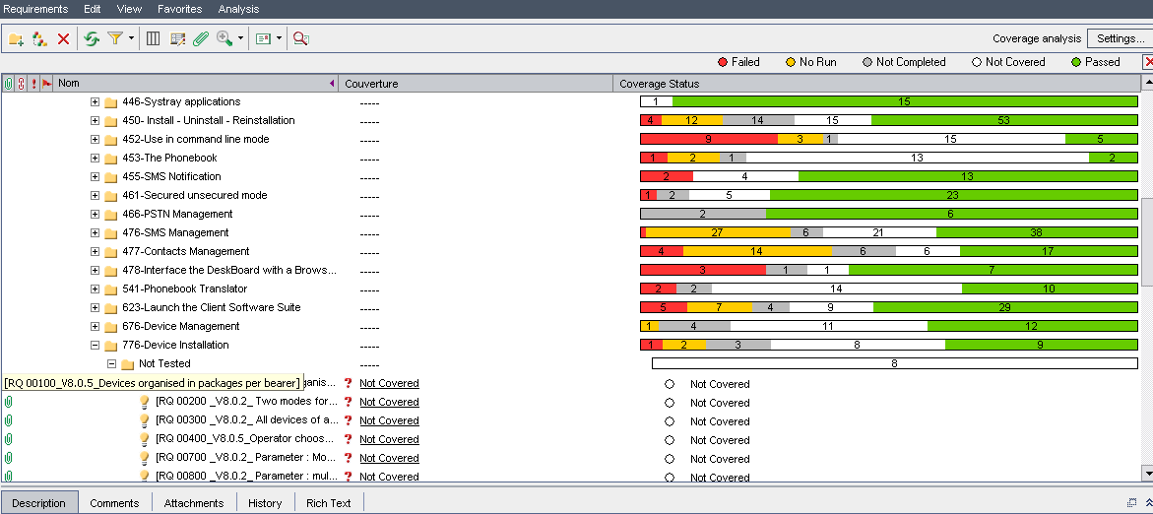
Quality Center
Notes:
Small introduction about kereval the company:
We do software testing, and we have got nice client

Slide 43
Redundant environment configurations
Variability matrices are handled independently.
Requirement of different functional domain sometimes tagged with the same features
Redundant configurations
In Biew : 149 redundant configurations.
Environment features are considered as totally independent
A global approach is necessary to avoid these redundant configurations and save cost.

Slide 44
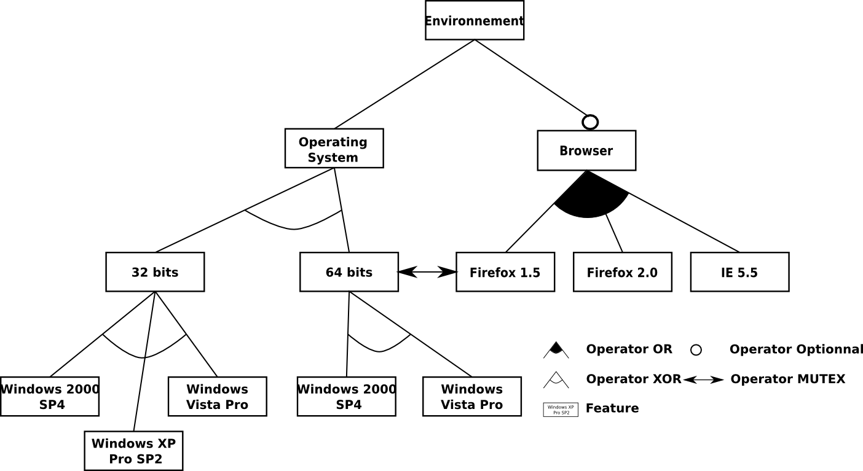
Innovation: explicit variability model
Need a variability model

Slide 45
Systematic configuration selection
Research question:
How can we leverage an explicit model of variability to systematically select a subset of all configurations according to a specific criterion?

Slide 46
Combinatiorial explosion
Cell Phone
Basis
Extras
Com
Msg
Voice
Camera
MP3
Wi-Fi
Bluetooth
UMTS
MMS
SMS
3 MP
8 MP
Number of different configurations : 117.
Cell Phone | Basis | Msg | Voice | MMS | SMS | Extras | Camera | 3 MP | 8 MP | MP3 | Com | Wi-Fi | Bluetooth | UMTS
✓ | ✓ | ✓ | ✓ | ✓ | ✓ | ✓ | ✓ | ✗ | ✓ | ✗ | ✓ | ✓ | ✓ | ✗
✓ | ✓ | ✓ | ✓ | ✗ | ✓ | ✓ | ✗ | ✗ | ✗ | ✓ | ✗ | ✗ | ✗ | ✗
✓ | ✓ | ✓ | ✓ | ✓ | ✓ | ✓ | ✗ | ✗ | ✓ | ✓ | ✓ | ✓ | ✗ | ✓
valid configuration
valid configuration
invalid Configuration

Slide 47
Pairwise coverage : a combinatorial testing approach
Pairwise selects representative configurations.
Pairwise coverage : selects a subset of configurations such as each pair of feature values is tested in one configuration at least.

Slide 48
Pairwise Coverage, example
4 features : {Com, Wi-Fi, Bluetooth, UMTS}
2 possible values : 0 (✗), or 1 (✓)
Exhaustive testing : 16 configurations
N features →2^{n} Configurations.
Com | Wi-Fi | BT | UMTS
0 | 0 | 0 | 0
0 | 0 | 0 | 1
0 | 0 | 1 | 0
0 | 0 | 1 | 1
0 | 1 | 0 | 0
0 | 1 | 0 | 1
0 | 1 | 1 | 0
0 | 1 | 1 | 1
1 | 0 | 0 | 0
1 | 0 | 0 | 1
1 | 0 | 1 | 0
1 | 0 | 1 | 1
1 | 1 | 0 | 0
1 | 1 | 0 | 1
1 | 1 | 1 | 0
1 | 1 | 1 | 1

Slide 49
Pairwise Coverage, example
4 features : {Com, Wi-Fi, Bluetooth, UMTS}
2 possible values : 0 (✗), or 1 (✓)
Pairwise coverage: 5 configurations
Com | Wi-Fi | BT | UMTS
0 | 0 | 0 | 0
0 | 1 | 1 | 1
1 | 0 | 1 | 1
1 | 1 | 0 | 1
1 | 1 | 1 | 0

Slide 50
Pairwise Coverage, example
Feature models enables invalid pairs and invalid configurations.
Com
Wi-Fi
Bluetooth
UMTS
Com | Wi-Fi | BT | UMTS
0 | 0 | 0 | 0
0 | 1 | 1 | 1
1 | 0 | 1 | 1
1 | 1 | 0 | 1
1 | 1 | 1 | 0

Slide 51
Pairwise Coverage, example
4 features : {Com, Wi-Fi, Bluetooth, UMTS}
Constraint between features.
Pairwise coverage: 4 configurations
Com
Wi-Fi
Bluetooth
UMTS
Com | Wi-Fi | BT | UMTS
0 | 0 | 0 | 0
1 | 0 | 1 | 0
1 | 1 | 0 | 1
1 | 1 | 1 | 0

Slide 52

Contribution : Pacogen
A tool which generates pairwise configurations from feature models.
Feature model
Pacogen
Pairwise Configuration

Slide 53

Number of configurations
Models | Model Metrics
 | number of features | number of configurations
Stack FM | 17 | 432
Crisis Management | 17 | 20
Fame dbms | 21 | 320
Smart Home | 35 | 1048576
Inventory | 37 | 2028096
Sienna | 38 | 2520
Web Portal | 43 | 2120800
Doc Generation | 44 | 55700000
Arcade Game | 61 | 3300000000
Model transformation | 88 | 1,65E+13
Coche Ecologico | 94 | 23200000
Electronic Shopping | 287 | 2,26E+49
Intel I Core 7
4 GB ram

